Slide 1
EPG SW Requirements Training
Authoring DCRs in HSD
Brian Kantor
11/18/2020 (rev 1.01)

Slide 2
Overview
EPG is moving to HSD-ES for all Requirements Tracking
EPG is moving from Jama to HSD-ES for all requirements management, including LZ, PRD and ingredient requirements.
This presentation focuses on HSD-ES usage by the EPG SW CCB for software ingredient requirements.
This presentation assumes that you understand the current Jama SW requirements processes.
Non-SW usage of HSD-ES for requirements management is out of scope for this presentation.

Slide 3
Why HSD?
Intel IT is ending support for Jama at Intel at the end of 2020.
IT mandate for teams comprised of SW, FW and HW is to use HSD-ES for requirements.
Provides a single database for requirements, test cases and bugs for improved traceability.
Supports all required db capabilities we use in Jama today.
API support for reports and existing SW DCR tools (i.e. DCRViewer)

Slide 4

Migration from Jama to HSD
IT has migrated all records from the Jama ND Projects to HSD-ES.
Migration includes:
Complete data from all records
Relationships between records
Jama specific metadata (i.e. Jama ID, Jama path)
Migration specifics vary by Jama record type but there should be no data loss from Jama
IT has committed to keep Jama4 running (read-only) for 1 year

Slide 5
Existing SW CCB Process We Will Keep
There are no EPG SW CCB process changes associated with this move to HSD-ES. We’re only changing tools.
The following remain the same as they were with Jama:
  SW DCR approval / commit process.
  SW DCR submission process
  SW DCR implementation tracking process
  Support for SW DCR Tools: DCRViewer, DCRLookup, HW View
Summary: Submitters and consumers of SW requirements should mostly be unaffected by this change.

Slide 6
What’s changing?
SW Requirements authors will write and manage SW requirements in HSD-ES instead of Jama.
The HSD-ES schema for requirements is quite different than the HSD-ES you’re familiar with for bug tracking.
We tried to make the HSD-ES schema for requirements as similar to the Jama schema as possible.
This slide set is intended both for training and for reference.
Notes:
The slides are wordy; recommend not reading ahead during training as we will talk to all points and you can review later for reference.

Slide 7
Using HSD-ES
Terminology and Definitions

Slide 8
Requesting Access to HSD
For Production HSD-ES Access for requirements:
Go to AGS: https://ags.intel.com
Click on: "Submit Request for Me"
Search for and Add the following roles to the request:
    “HSDES_SPL_Planning_ReadWrite”
    “HSDES_SPL_Dyn_Lookup_Read” ¹
Provide Justification: “EPG SW Requirements Lead”
Submit
Request will be reviewed and approved, usually takes a day due to TAC sync.
Incorrect or improperly filled out requests will be rejected.
¹ SPO SPA’s need write access to dyn_lookup

Slide 9
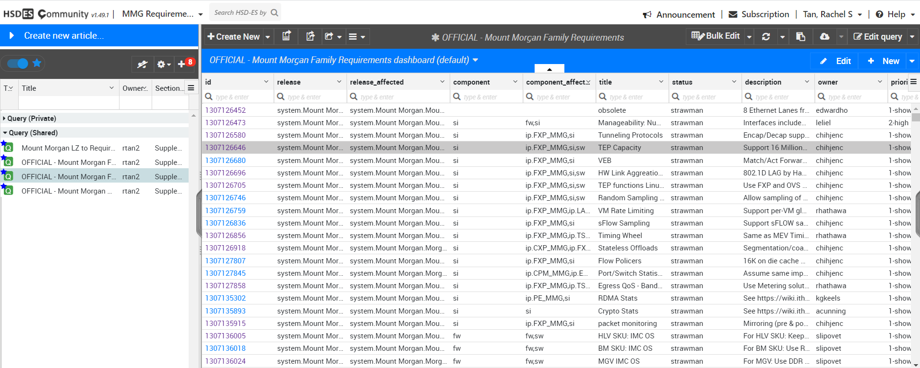
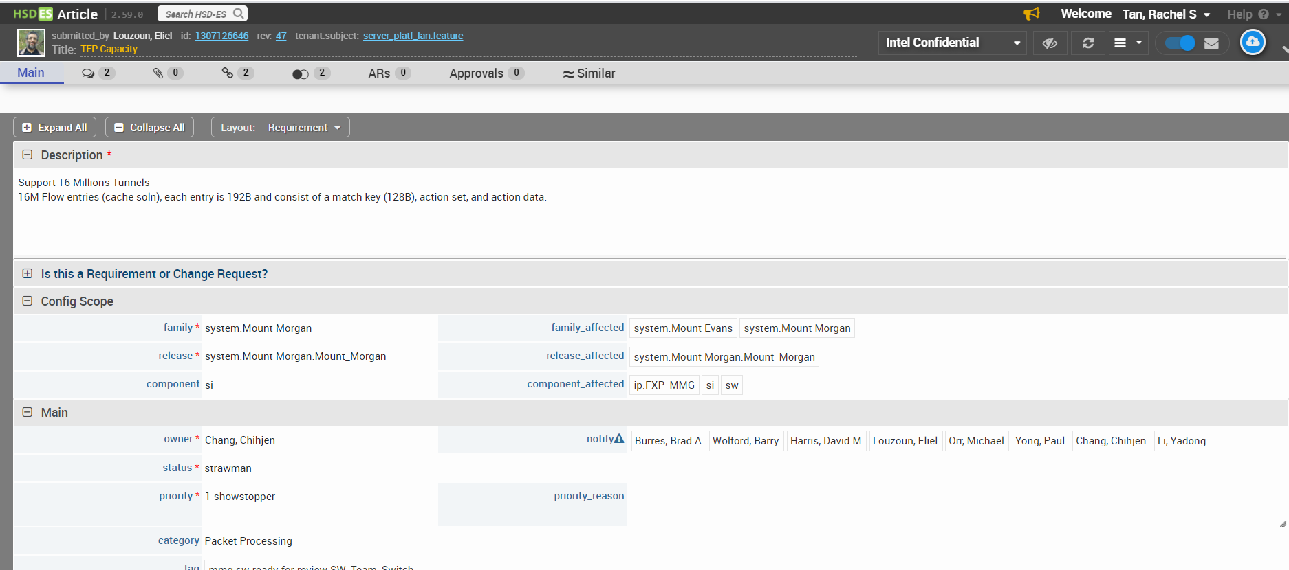
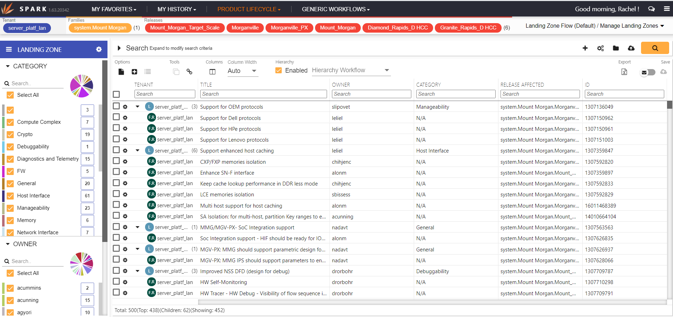
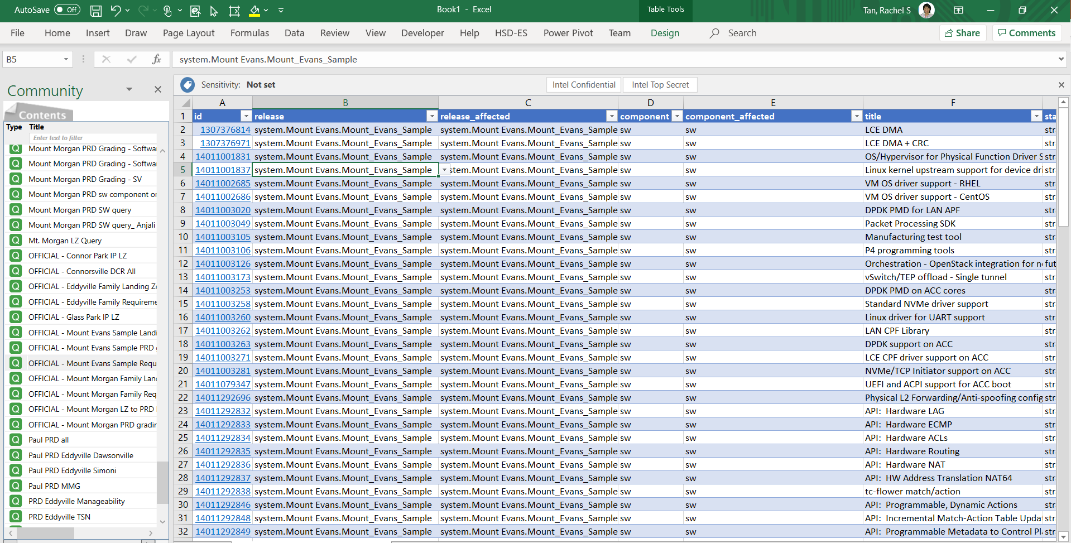
3-ways to access data in HSD-ES
Web: Community/Article
View/update one record at a time
Web: Spark
ES-Excel
View/update multiple records at a time
Manage requirements and links using workflows
Notes:
This presentation does not cover Excel plug-in

Slide 10
HSD Terminology
  The following slides will cover important HSD Terminology
  Articles
  Tenant
  Subjects
  Sub_types
  Layout templates
  BOM (Family.Release.Component)
  Release vs. Project
  Links
  Community
Notes:
It’s best if we all use the same language

Slide 11
What is an Article?
An article is a single record in the HSD-ES database.

Slide 12
What is a Tenant?
  An HSD tenant is roughly equivalent to a Jama Project (i.e. ND Project).
  A tenant is a collection of articles of various subjects and accessible by various user permission groups.
  For EPG SW we have a single tenant – server_platf_lan
    This is an all-encompassing container used for all EPG SW and PMO and NPO programs.

Slide 13
What is a Subject?
An HSD subject is a container of articles of the same type.
  All articles within a subject have the same set of fields.
Subjects are visible to all corporate HSD users and tightly controlled by IT.
  We cannot define our own custom record types like we had in Jama.
Three Subjects relevant for EPG SW ingredient requirements:
  .feature
  .dyn_lookup
  .doc_tracking
Notes:
Subjects can be extended per tenant. We have tenant specific fields in our .feature subject. But corporate fields cannot be removed from subjects.

Slide 14
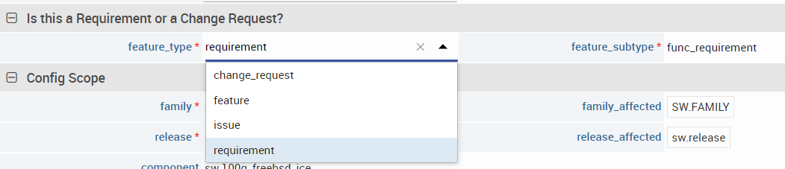
Sub-types in Subjects
Subjects can be sub-divided using types and sub-types which are configurable by the business group.
Sub-types are defined by ‘type’ fields which vary by subject.
Different sub-types can use vastly different subsets of fields from the subject.
Example: The .feature subject contains both ‘change_requests’ and ‘requirements’. These are differentiated by the “feature_type” field.
Notes:
Some sub-types have sub-sub-types.

Slide 15
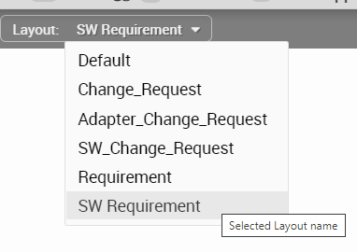
Layout Templates
A layout template determines which fields to display and which rules to apply to the article based on sub-type.
The correct layout is automatically selected based on the subject sub-type for existing articles.
The layout is not auto-selected for new or modified articles.
The layout can be manually selected using the layout menu.

Slide 16
What is a BOM?
The BOM is a logical hierarchy comprised of the Family, Release and Component fields.
The BOM determines the scope of the article; what it is applicable to.
HSD is a flat database; it does not have folders like Jama. The BOM is used in HSD to group requirements similar to how folders were used in Jama.
To separate SW requirements from product and NPO requirements a special pre-defined SW BOM is used:
  family = SW.FAMILY
  release = sw.release
  component = <SW component list; same as Jama>
Release and Component values are filtered based on Family and Release settings
Notes:
Bill of Materials
The BOM is hierarchal.
- The selected family determines the list of releases you can chose from
The selected release determines the list of components you can choose from.
This makes sense for platforms but not so much for SW

Slide 17
Release vs Project
“Release” is overloaded term in HSD.
The Release field in the BOM is not the same as SW project.
The Release in HSD is the program level SKU an article is specific to.
The SW project an article is targeted at is stored in the target_project field.
Notes:
Remember that HSD was designed for platform teams. Not SW teams.

Slide 18
What are Links?
Links are equivalent to Jama relationships and are used the same way.
Links are parent-child relationships between articles of any type.
  Parent = upstream
  Child = downstream
EPG SW uses links to show how articles are tied together to support a feature or release.
Links connect requirements, DCRs and devices.
Traceability is achieved by linking SW articles to higher level requirements (i.e. PRD, pDCRs) and to Test Cases.
Notes:
HSD also supports links between articles in different tenants or subjects.
Linking to PRD/PDCRs and Test Cases is out of scope for this presentation.

Slide 19
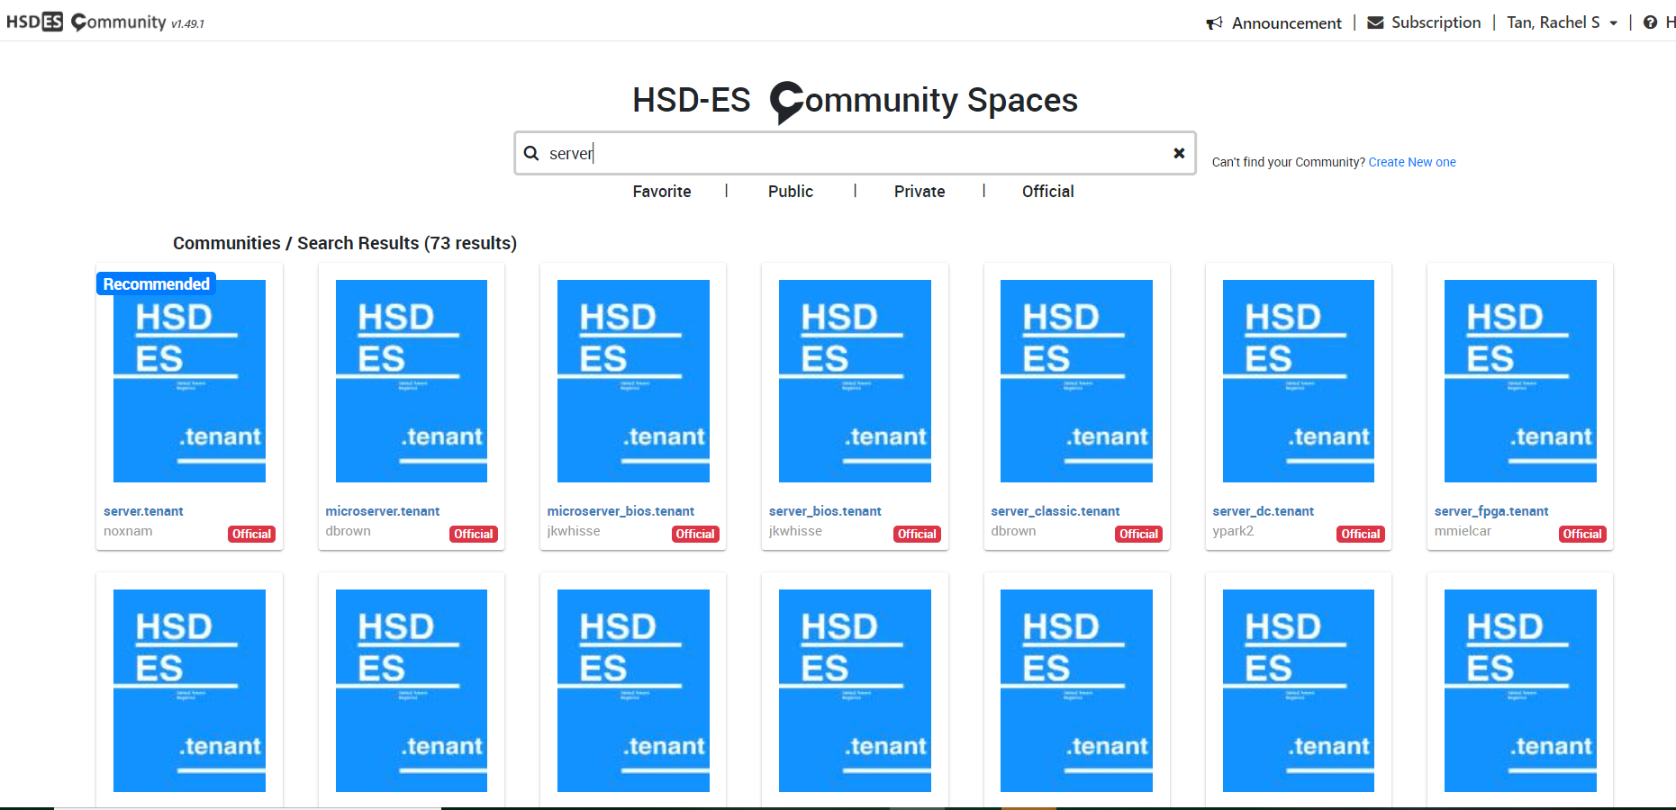
What is a Community?
An HSD community is a user-defined container of queries.
A customizable view into a tenant, can be private or public.
These used to be called magazines.
There is no Jama equivalent.
“EPG SW Requirements Authors” community is a SW requirements centric community with helpful SW queries.
Note: you cannot save queries to server_platf_lan.tenant community

Slide 20
What is a SW DCR in HSD
Article Types and Schema

Slide 21
What is a SW DCR in HSD
A SW DCR is comprised of the following:
A SW Change Request article with:
  0-to-many linked SW Requirements articles
  0-to-many linked hw_device articles
  0-to-many linked appendix articles
(Basically unchanged from Jama)

Slide 22
SW Change Request: Definition
A SW Change Request is an article in the .feature subject with the following BOM and Type field values:
Field | Value
family | SW.FAMILY
release | sw.release
feature_type | change_request
change_type | modify
These field values differentiate the SW change request article from articles of other types in the .feature subject (i.e. PDCRs and requirements).
SW change requests use the SW_Change_Request layout template.

Slide 23
SW Change Request: Field Mapping
  These change_request fields are used the same way as they were in Jama but some have new names.
Jama | HSD-ES
DCR Number | dcr_number
Short Name | title
Reason for Change | reason_for_change
Summary of Change | Description
Priority | priority
Change Request Disposition | status
DCR Lead | owner
Release | target_project
Customer | customer
Affected OS | os_affected
Tags | tag
Notes:
Don’t go over these in detail

Slide 24
SW Change Request: New Fields
Following are new fields in the SW Change Request articles in HSD that have no Jama equivalent.
Some are required by HSD but are not used for SW process.
Field | SW Usage
motivation | Pick list for high level reason for change. Required.
priority_reason | Rationale for the priority value. Not commonly used.
Security Trip Wire | Security questionnaire. May replace the current CCB process for security questionnaire in the future. Required.
scenario_type | HSD required field. Not used by SW CCB. Set to ‘formal’.
por | HSD required field. Not used by SW CCB. Ignore.
Notes:
Example: https://hsdes.intel.com/appstore/article/#/22011671468

Slide 25
SW Requirement: Definition
A SW requirement is an article in the .feature subject with the following BOM and Type field values:
Field | Value
family | SW.FAMILY
release | sw.release
feature_type | requirement
feature_subtype | func_requirement ¹
These field values differentiate the SW requirement article from articles of other types in the .feature subject (i.e. change_requests and product requirements).
SW requirements use the SW Requirement layout template.
¹ Usage of other feature_subtypes such as perf_indicator may be defined later

Slide 26
SW Requirement: Field Mapping
Jama | HSD-ES
Short Name | title
Requirement | Description
Rationale | reason_for_change
Notes | notes
Status | status
Priority | priority
Planned Release | target_project
Affected Component | component
Affected Operating Systems | os_affected
Source | source_other
Originating Document | originating_document
Release Date | release_date
Deprecated Date | deprecated_date
Tags | tag
  These requirement fields are used the same way as they were in Jama but some have new names.
  The family and release fields must be correctly set before setting the component field.
Notes:
Component is part of BOM and dependent on family/release

Slide 27
SW Requirement: New Fields
Following are new fields in the SW Requirement Articles in HSD and have no Jama equivalent.
Some are required by HSD but are not used for SW process.
Field | SW Usage
owner | Author / point of contact for the requirement. Required
motivation | Pick list for high level reason for change. Required.
delivered | Bool. Set by NDSWDCR when the target project PV’s.
priority_reason | Rationale for the priority value. Not commonly used.
scenario_type | HSD required field. Not used by SW CCB. Set to ‘formal’.
por | HSD required field. Not used by SW CCB. Ignore.
Notes:
Example: https://hsdes.intel.com/appstore/article/#/22011677358

Slide 28
Status Field
The status field values in HSD are defined by the subject and cannot be changed.
These values are different than Jama status values.
Many of the values are not used for SW Change Requests or SW Requirements.
HSD Value | SW Usage
complete | Not used by SW CCB process. Do not use.
future | Not used by SW CCB process. Do not use.
open | Draft/Initial Review/PDT Review (set by DCR lead)
por | Approved (set by NDSWDCR)
por-1 | Not used by SW CCB process. Do not use.
rejected | Rejected/Withdrawn/Removed (set by NDSWDCR)
strawman | Not used by SW CCB process. Do not use.

Slide 29
HW Device: Definition
A hw_device is an article in the .dyn_lookup subject with the following Type field value:
Field | Value
lookup_name | hw_device
This field value differentiates the hw_device article from articles of other types in the .dyn_lookup subject (i.e. target_project and os_affected).
hw_device articles use the HW_Device_Records layout template.
SPO SPAs own the creation and management of HW Device articles. (same as Jama)

Slide 30
HW Device: Field Mapping
Jama | HSD-ES
Code name | title
Branding String | branding_string
VendorID | vendor_id
DeviceID | device_id
SubVendorID | subvendor_id
SubDeviceID | subdevice_id
Silicon | silicon
Description | Description
Originating Document | originating_document
Release | target_project
Base Driver OS Support | base_driver_os_support
Tags | tag
  These device fields are used the same way as they were in Jama but some have new names.

Slide 31
HW Device: New Fields
Following are new fields in the HW Device articles in HSD and have no Jama equivalent.
Some are required by HSD but are not used for SW process.
Field | SW Usage
owner | Author / point of contact for the device. (SPA)
value | Contains an HSD friendly version of the device name from the title field. All lowercase and no special characters.
status | Set to ‘inactive’ for devices which are deprecated or should not be use for new SW requirements.
visibility | Bool. Automatically set when ‘status’ is changed.
scenario_type | HSD required field. Not used by SW CCB. Set to ‘formal’.
Notes:
Value field would be used if devices were to be used as pick-list items.
Value field has metadata describing the device in consistent format (see backup)

Slide 32
DCR Appendix: Definition
A SW DCR Appendix is an article in the .doc_tracking subject with the following Type field value:
Field | Value
Type | SW Document
This field value differentiates the appendix article from articles of other types in the .doc_tracking subject (i.e. customer documents).
SW DCR Appendices use the SW_Document layout template.
These are equivalent to the Text records in Jama and are displayed at the end of the DCR in DCRViewer.

Slide 33
Links Used In SW DCRs
Parent
PRD Reqmt.
PDCR
Links are used to tie together articles from different sources.
The directionality of the links is critical for DCRViewer functionality. HSD refers to this directionality as parent/child.
HW devices are always parents of SW Change Requests and SW Requirements
SW Change Requests are always parents of SW Requirements and Appendices
Links from the HW Device define all requirements for that device.
Directional links provide traceability from the product requirements down to the SW Requirements and test cases (not shown).
HW Device
SW Change
Request
Appendix
SW Reqmt.
Child
Notes:
Same as Jama
A SW Requirement may link to other subsequent SW Requirements. This helps to show interdependencies.
Care must be taken not to create circular references.

Slide 34
SW Records Migrated
From Jama

Slide 35
Special Fields Migrated from Jama
The following fields were migrated from Jama to HSD to provide context about the record from Jama
These fields are not used for new articles in HSD and should never be manually set.
The version history from the original Jama record is also migrated to HSD and included in the Comments field.
All relationships between Jama records were migrated to HSD
Value | Usage
jama_global_id | The global ID value of the original Jama record
jama_id | The ID value of the original Jama record
jama_item_type | The object type of the original Jama record (i.e. “ND SW Requirement”)
grouping | The full path to the original Jama record in the Jama hierarchy.

Slide 36
Creating SW DCRs in HSD

Slide 37
Creating a DCR: SW Change Request
The SW DCR Submission page automatically creates a SW Change Requests article in HSD and assigns a DCR number.
The DCR can then be:
    Viewed in DCRViewer
    Edited in HSD / Spark
  The following fields are set by the DCR submission page and must not be changed by the DCR lead:
    feature_type: “change_request”
    change_type: “modify”
    family and release (BOM): “SW.FAMILY” and “sw.release”
    dcr_number
    status: “open”

Slide 38
Creating a DCR: DCRViewer Sections
  The following are sections displayed by the DCRViewer and how they are populated
  Affected Components
    The Affected Components table is stored in a separate database. There is a link to it in DCR Viewer.
    The DCR Lead opens the Affected Components database, and selects all affected components, and enters target milestones for each. Don’t forget to click save.
  Affected Devices
    The list of hw_device articles which are linked as parents of the change_request
  Affected OS List
    The list of OS’s from the affected_os field of the change_request article. Select the superset of all OSes from the requirements linked to the DCR.
    (same as Jama)
Notes:
Same as Jama
This info was lacking in original Jama training

Slide 39
Creating a DCR: DCRViewer Sections – Cont.
  Detailed Requirements
    New requirements introduced in this DCR
    All child requirements linked to the change_request with originating_document equal to the dcr_number
  Existing Requirements
    Existing requirements reused by this DCR
    Typically used for applying an existing requirement to a new device.
    All child requirements linked to the change_request with originating_document not equal to the dcr_number
  Appendices
    Extra non-requirement information. Typically implementation or validation details.
    One appendix per child doc_tracking article linked to the change_request
Notes:
Basically the same as Jama

Slide 40
Creating a DCR: Add Requirements
    New requirements are created in the .feature subject linked as children of the change_request.
    Use Spark or HSD Article app to create individual requirements and link them to the change request.
    Spark (BKM):
    Select change_request and use “Add new child SW Requirement” workflow – creates empty SW requirement linked to selected change_request.
    HSD Article: options
    Use “Create New” in the .feature subject – creates a blank article which requires manual linking to the change_request
    Important: Articles in HSD cannot be deleted. Be careful not to create unwanted requirement articles.
Notes:
Link can be created in Article App using Link tab and enter the ID

Slide 41
Creating a DCR: SW Requirement Fields
  SW Requirements are component specific
    There are no global requirements. For requirements that cover multiple components, separate component specific requirements are created. (same as Jama)
    Field values of note for new requirements
    title: brief but descriptive text
    feature_type: “requirement”
    feature_subtype: “func_requirement”
    family.release (BOM): “SW.FAMILY” and “sw.release”
    component: SW component the requirement is applicable to.
    status: “open”
    originating_document: DCR# which introduced the requirement
    source_other: who requested the requirement (ie. customer)
    os_affected: select all applicable OSs
    delivered/release_date/deprecated_date: leave blank
    tag: “GLS” if requirement has localization impact

Slide 42
Submitting a Completed SW DCR for PDT Review
Process is same as it was with Jama
Open DCR Details page. (link in DCRLookup)
Click “Edit”
Change DCR “State” to “PDT Review”.
An email will automatically be sent out to CCB DCR Reviewers.

Slide 43
DCRs: Post Approval Flows
DCR Approval:
When a DCR is approved, NDSWDCR will change the status to ‘por’ for the change_request and all requirements linked to the change_request where originating_document equals the DCR number.
Project PV:
At project PV, NDSWDCR will update the release_date and set delivered=yes for all SW requirements where target_project is equal to the project that PV’d.
Notes:
Basically equivalent to Jama process

Slide 44
Using Spark

Slide 45
What is Spark
GUI for HSD-ES to visualize requirements and links using workflows
Best app for viewing and managing links
Displays links in a hierarchical view.
Graphical view of link matrix for comparison and copying.
https://hsdes.intel.com/appstore/spark/

Slide 46
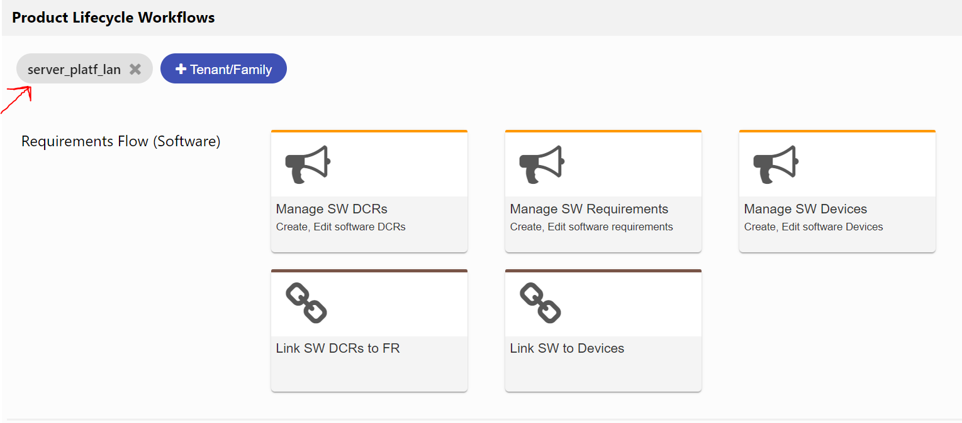
Spark: SW Workflows
Spark has five SW specific workflows for the most common SW requirements activities
To see these workflows ‘server_platf_lan’ tenant must be selected.

Slide 47
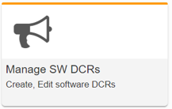
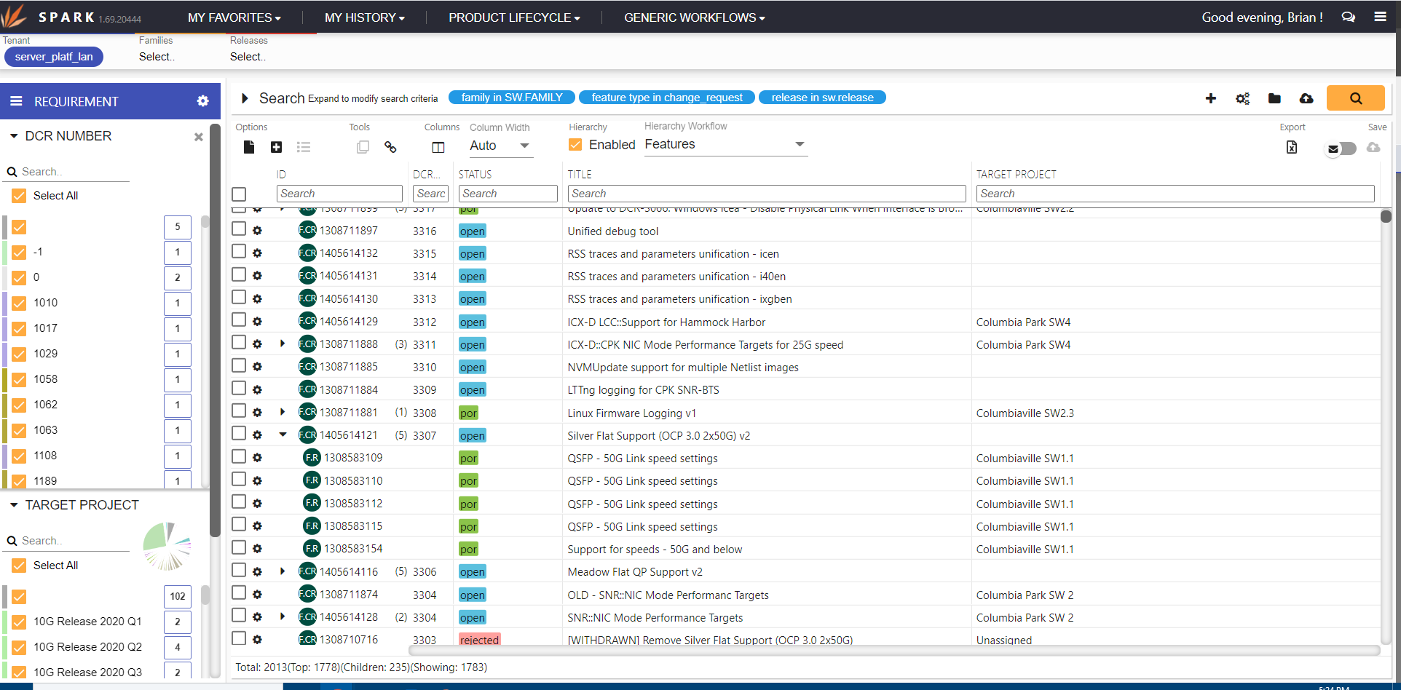
Manage SW DCRs
Workflow to view/manage/edit SW change_requests.
  View/Edit SW change_request articles
  Add new child requirements to a change_request
  View requirements linked to change_request
Displays child requirements in a hierarchy

Slide 48
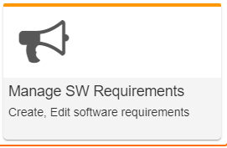
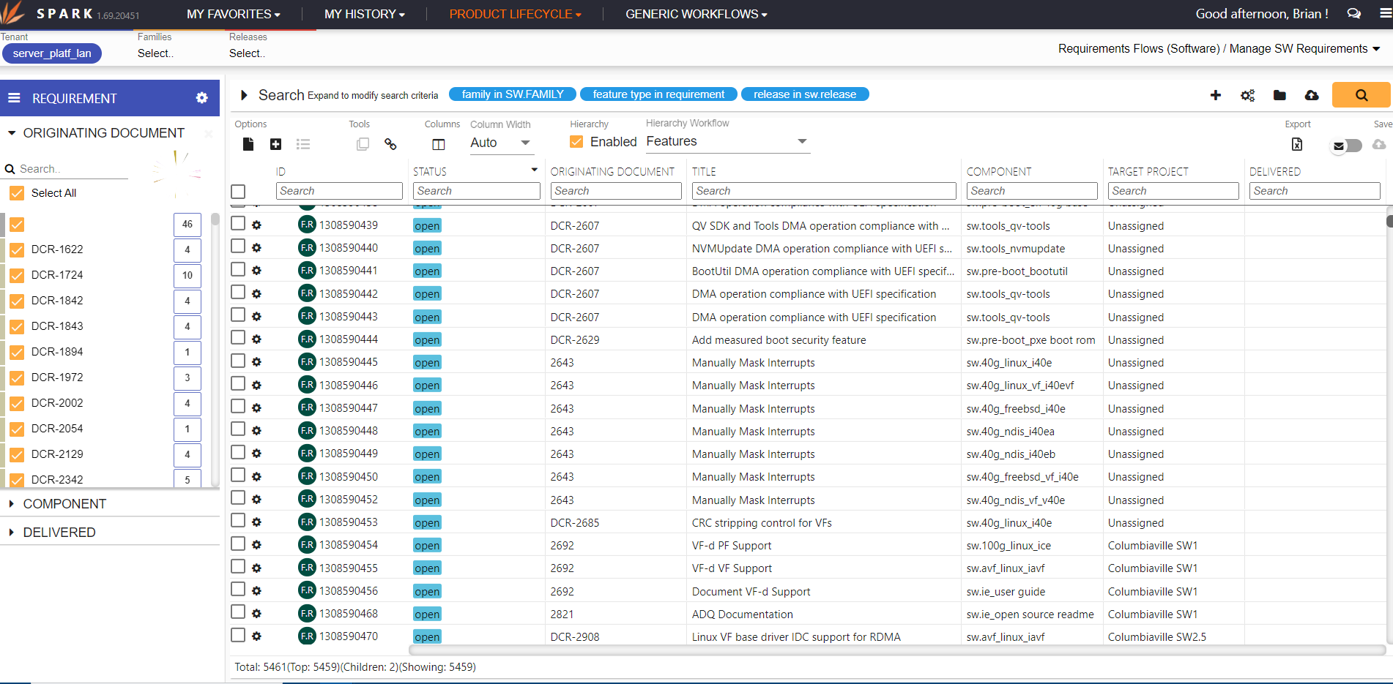
Manage SW Requirements
Workflow to view/manage/add/edit SW Requirements
  View/Edit single requirements or Bulk update
  Copy single requirements or Advanced Clone
  Advanced searches
  Export requirements to Excel

Slide 49
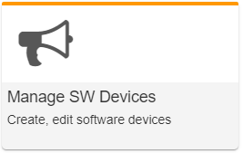
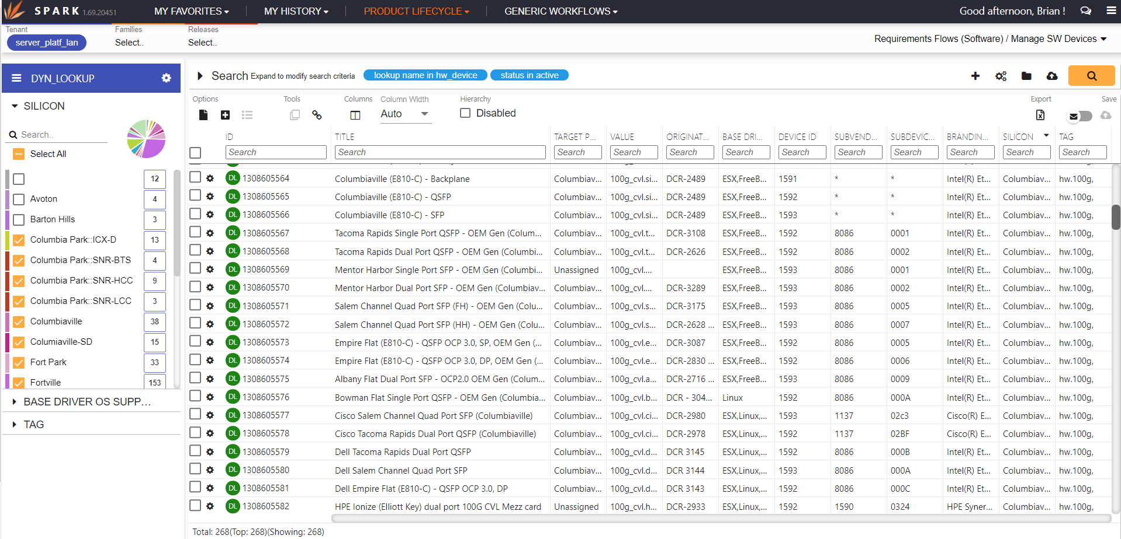
Manage HW Devices
Workflow to view/manage/add/edit all HW Devices
  View/Edit single device or Bulk update
  Advanced searches
  Export devices to Excel

Slide 50
Spark Management View – Demo
Quick Filters
Gear (Edit | Workflow options: Add child | Copy | Link)
Hierarchy View
  Add/Remove child requirements
Bulk Update
  Bulk Update of picklists
Advanced Search
Configuring Columns
Export to Excel
(See section 3 of the Spark User Manual for more details)

Slide 51
Spark Management View – Important Tips
Updates/edits are not immediate. Don’t forget to save your changes!
Spark does not automatically select a Layout template when viewing/editing individual articles.
You can customize the workflow/view (search, columns, etc)
  Custom workflows can be saved to My Favorites or shared via URL.
  Selections in Quick Filters cannot be saved
Searches can be saved but do not save view (i.e. columns)
Bulk update can add/remove entries in multi-select pick lists without overwriting other entries

Slide 52



Spark – Advanced Clone of Requirements
Select one or more requirements to copy and click “Advanced Clone”
Always use the “EPG SW – Reuse and Modify Requirement” cloning strategy for requirements.
Clone options:
  Override or clear select field values in new article.
  Create a link between original and new article
  Copy all links from original to new article
Important Note: Records in HSD cannot be deleted. Be careful not to create unwanted requirement records.
Notes:
Demo in Spark

Slide 53
Spark - Link Matrix View
Links are managed in Spark using the Link Matrix View.
SW has two Link Matrix workflows:
Link SW to DCRs
Link SW to Devices

Slide 54
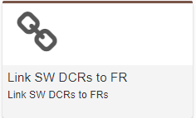
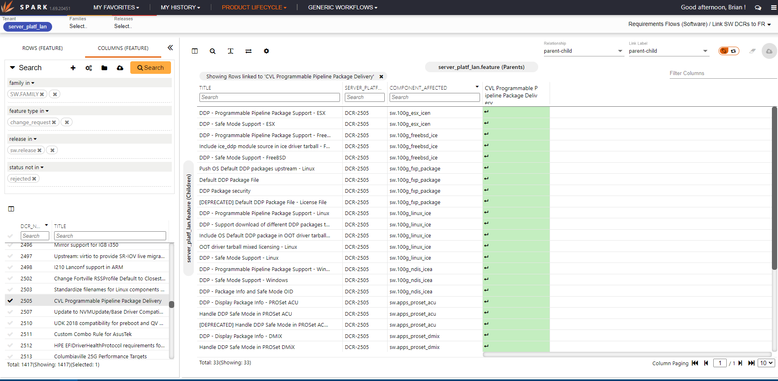
Link SW DCRs to Requirements
Workflow to view/manage/edit links between DCRs and child Requirements.
  Select the DCR
  View/Add/Remove links to SW requirements

Slide 55
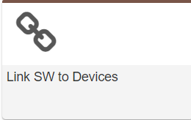
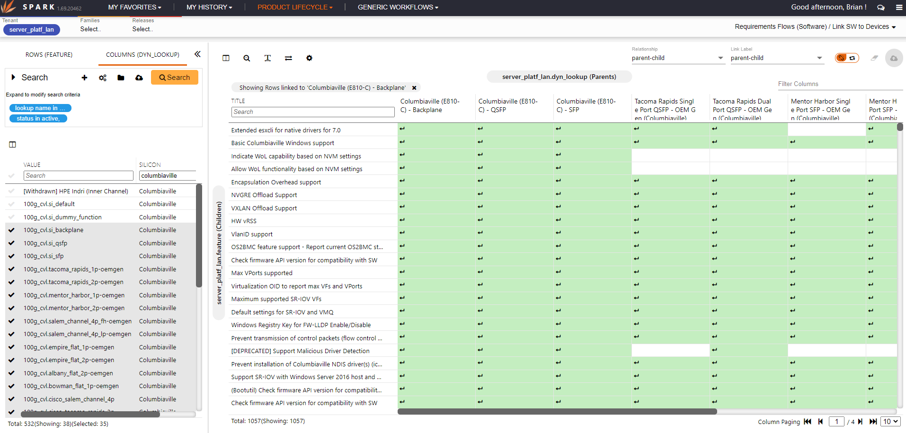
Link SW to Devices
Workflow to view/manage/edit links between Devices and child DCRs/Requirements.
  Select the Device(s)
  View/Add/Remove links to SW Requirements and DCRs

Slide 56
Spark Link Matrix – Demo
Row and Column configuration
Selecting Devices
Selecting DCRs/Requirements
Add/Remove Links
Copy Links from another article
Saving/clearing link changes
(See section 4 of the Spark User Manual for more details)

Slide 57
Spark Link Matrix View – Important Tips
Changes are not immediate. Don’t forget to save your changes!
EPG SW uses “parent-child” links. Do not use “related-links”
Columns = Parents; Rows = Children
Links can be copied from ‘like’ articles
  Use “show links only” -> “select all” to copy links from another article.
Custom matrix views can be saved to My Favorites or shared via URLs
Notes:
Copying links from parent-to-parent is easy.
Copying links from child-to-child not so easy. (Fix targeted for Jan ‘21)

Slide 58
What Spark is Good At
Spark is the BEST tool for:
Manage/Add requirements
Manage/Add/Edit links
Bulk update
Copy/Advanced Clone
Spark not currently the best tool for:
Advanced Search: Use Community App
View/Edit individual requirements: Use Article App
Spark is constantly improving
Notes:
Spark advanced search cannot include multiple instances of the same field. Does not support ‘does not include’ as search criteria for text fields or tags.
Article App copy/advanced clone has many issues
Article currently handles layout templates better than Spark
Article copy/advanced clone is effectively broken for requirements

Slide 59
Questions on HSD-ES usage
Contact any of the following for help in using HSD-ES.
Brian Kantor
Rachel Tan
NDSWDCR

Slide 60
Backup

